Slide 1

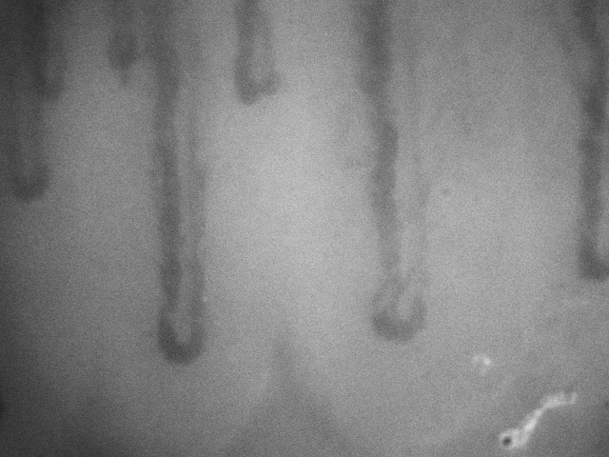
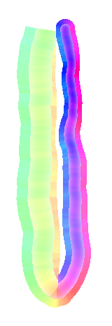




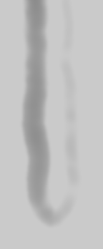
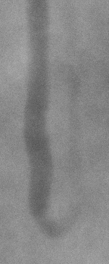
Simulating Nailfold Capillaroscopy Sequences to
Evaluate Algorithms for Blood Flow Estimation
P A Tresadern¹, M Berks¹, A K Murray ², G Dinsdale ², C J Taylor¹ and A L Herrick²
¹ Centre for Imaging Science, University of Manchester, UK; ² Centre for Musculoskeletal Research, University of Manchester, UK
Objectives
Flow Evaluation Results
Scan for videos
Simulate realistic nailfold capillaroscopy sequences with known flow parameters
Evaluate accuracy of optical flow algorithms when measuring blood cell velocity
Synthetic sequences
High flow rates increase estimation error substantially
Number of cells and contrast variation increase error, though to a lesser extent
Brightness variation also increases error but with limited effect
Example frame from a real capillaroscopy sequence.
True (left) and estimated (right) flow from simulated sequence. Colour indicates flow direction; brightness indicates flow speed (white = 0).
Simulation Method
Generate random vessel path
Define inner and outer walls of vessel
Fill vessel space with N blood cells
Determine velocity from vessel width for every pixel
Synthesize sequence of T ‘clean’ images
Add image artefacts (noise, shake, lighting variation)
Effects of flow parameters on error in estimated blood cell velocity. Flow rate has the greatest effect.
Real sequences
Quantitative evaluation not available as there is no ‘ground truth’
Qualitatively pleasing results, clearly capturing flow in the image
Real vessel (left) and its estimated direction of flow (right). Colour indicates direction of flow; brightness indicates frequency.
Conclusion
Flow experiments with simulated capillaroscopy sequences show promise, but suggest that algorithms must accommodate high flow rates (e.g. via coarse-to-fine estimation), and should pre-normalize and register images for best results.
1.
2.
3.
4.
5.
6.
philip.tresadern@manchester.ac.uk

